Slide 1
Turbine Performance Practice & Theory
Updates From The Leading Edge

Slide 2
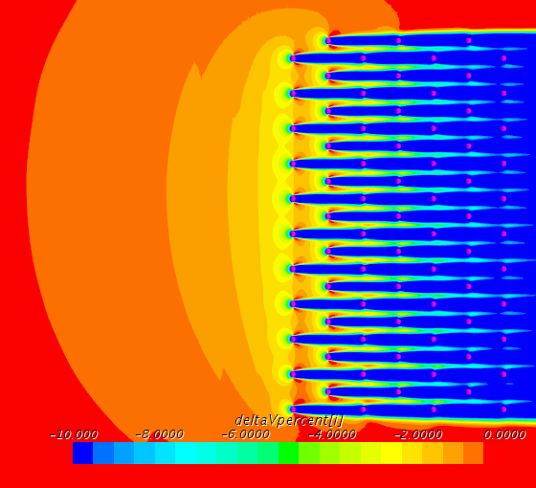
Wind Flow Blockage Due to Operational Wind Turbines
Presence of wind turbines slows the incoming free stream wind
Local effect caused by single turbine
Large-scale impact due to presence of neighbouring turbines

Slide 3
Translating Pre-Construction Wind Speed Measurements to Energy
Freestream wind speed measurements
Sales power curve
Expected energy output
Measured power data
Pre-construction measurements are freestream wind speed
Wind speeds measured in power curve tests are not freestream
Industry use of power curve measurements to correct for ‘outer range’ performance
Energy assessment requires a power curve representative of freestream wind speed for an isolated turbine

Slide 4
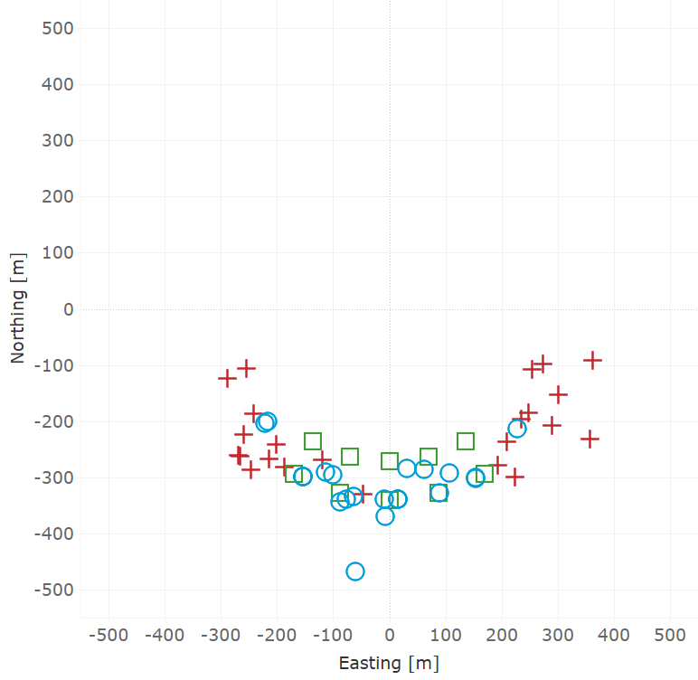

Real-world Blockage Impact
> 50 power curve test mast locations
Use CFD simulations to determine impact
Trends in mast placement by OEM

Slide 5
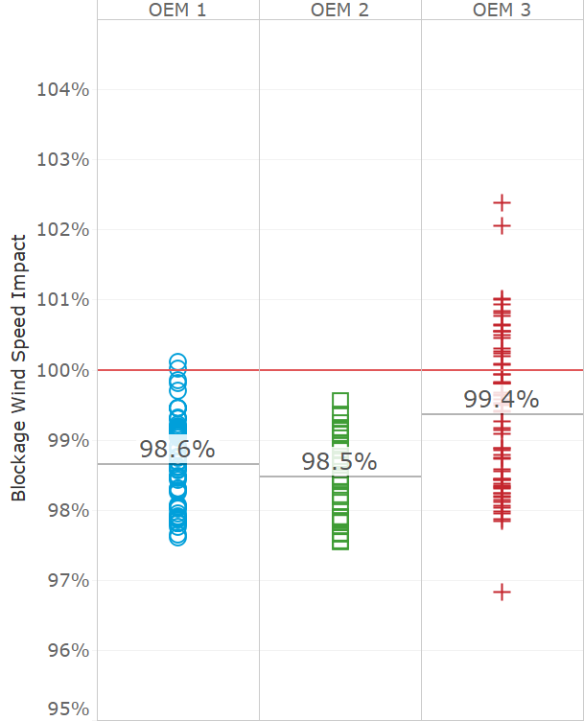
CFD Simulation Results
Magnitude of blockage impact is sensitive to relative mast location
OEM power curve test specifications and preferences determine mast positioning (within IEC guidelines)

Slide 6
Conclusions
Power curve test measurements of wind speed are not representative of true freestream conditions
Pre-construction energy assessments use power curve test measurements to ‘correct’ for outer range performance
CFD simulations have been used to determine blockage impact for real world test mast measurements
Variation in relative mast locations between different turbine manufacturers

Slide 7
Questions?
Carl Ostridge
carl.ostridge@dnvgl.com

